Slide 1
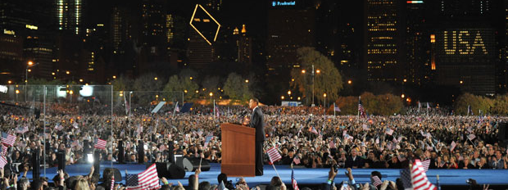
Voter Turnout In Chicago
Alex Douglas

Slide 2
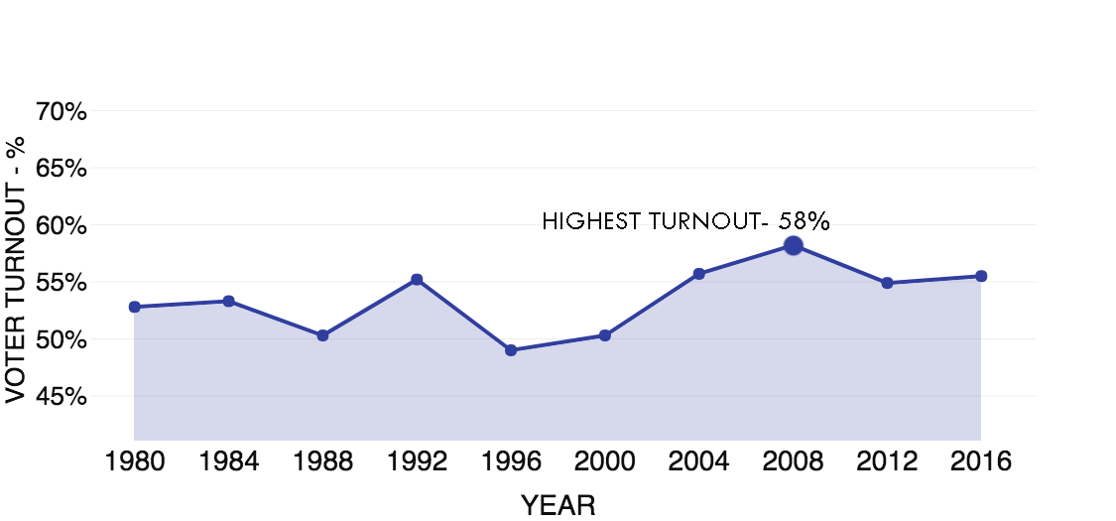
Nationwide Voter Turnout

Slide 3
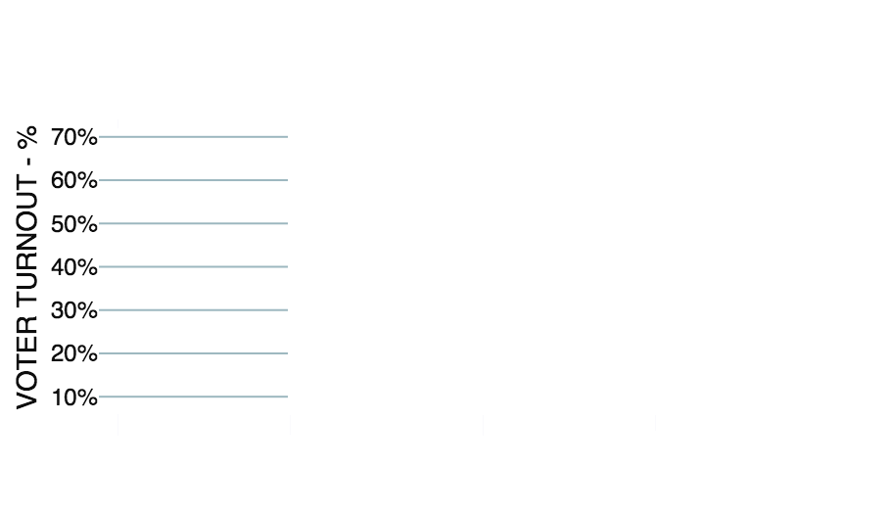
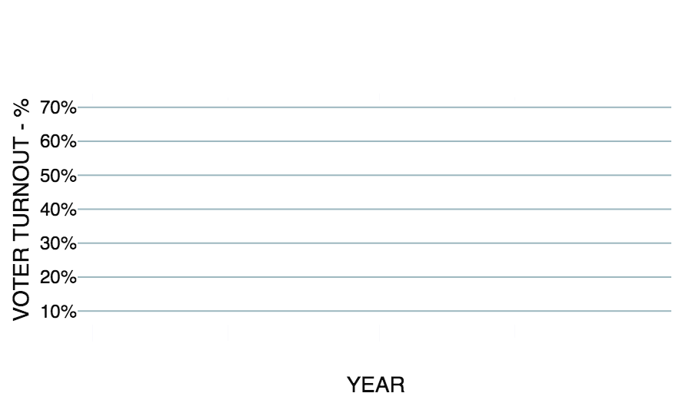
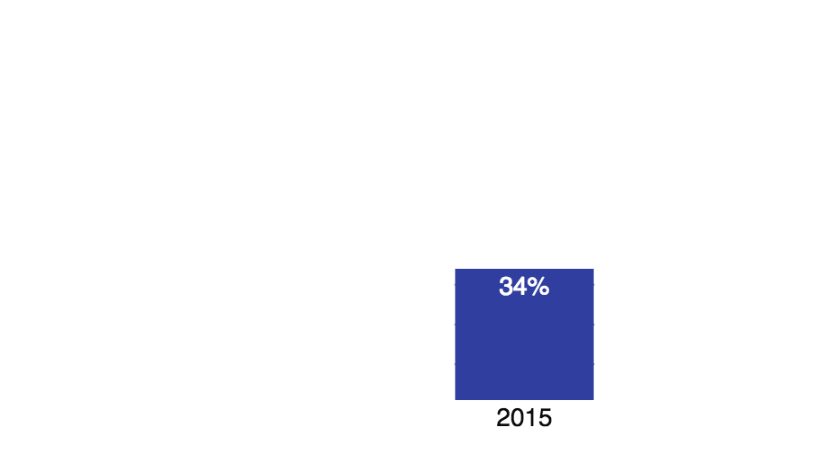
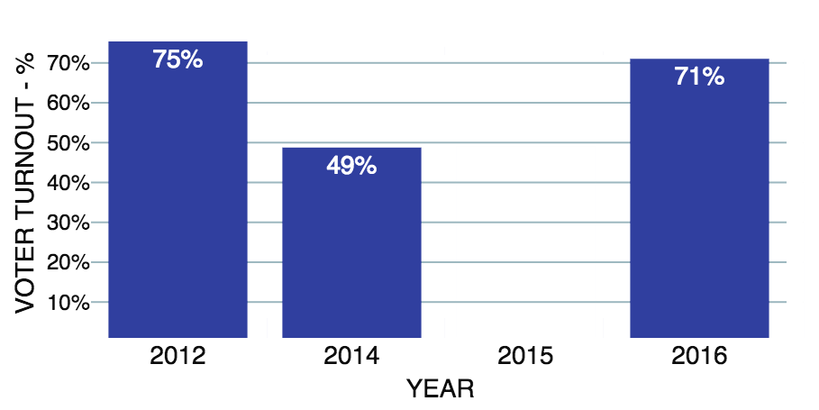
recent Chicago elections – voter turnout

Slide 4
Data Gathering
Demographics
Crime
Walkability
Polling Stations
SOURCE
U.S. Census Bureau
SOURCE
Chicago Data Portal
SOURCE
walkscore.com
SOURCE
Chicago Board of Elections
28 features – 3 categorical, 25 quantitative

Slide 5
Model Results
25 features statistically significant
R² – 0.864
Cross-Validated R² – 0.866
Focus on descriptive power of linear regression
No regularization or feature interaction
Some features more impactful than others

Slide 6
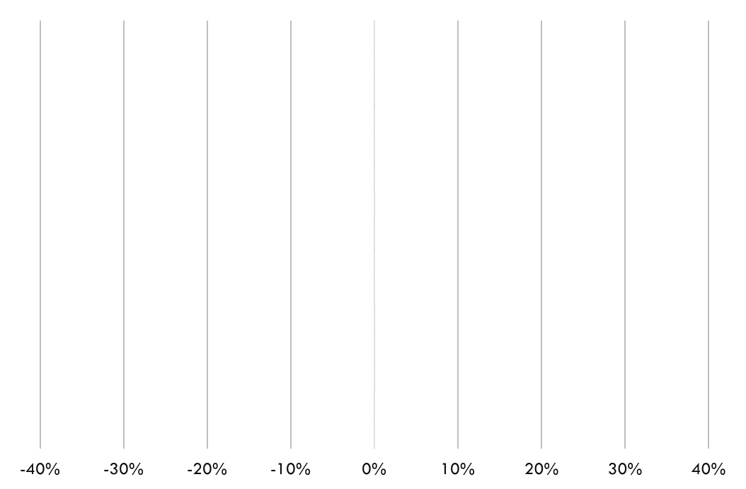
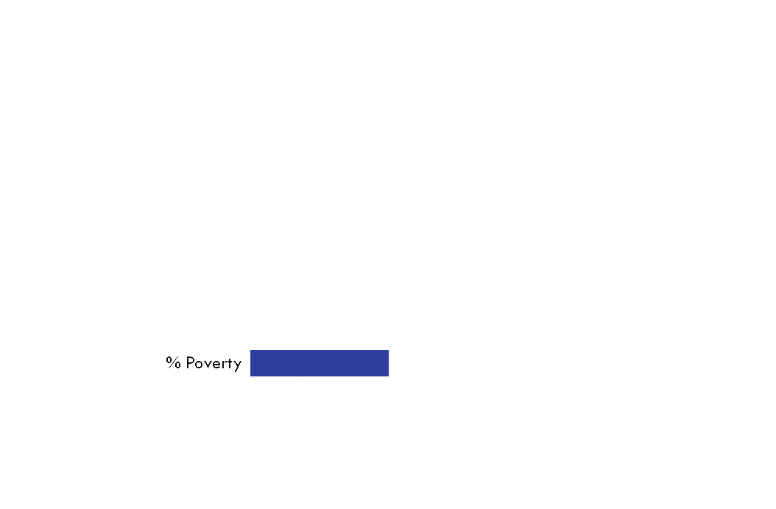
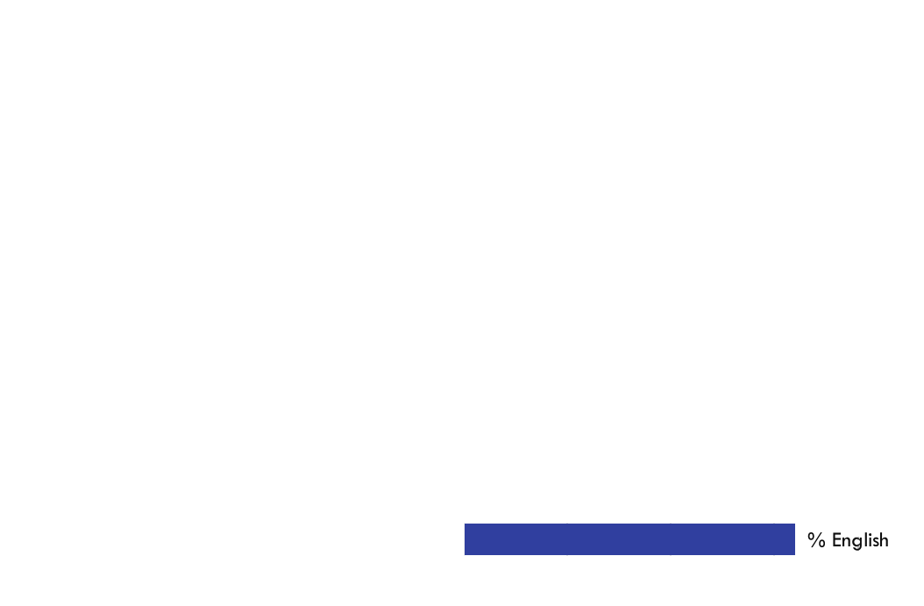
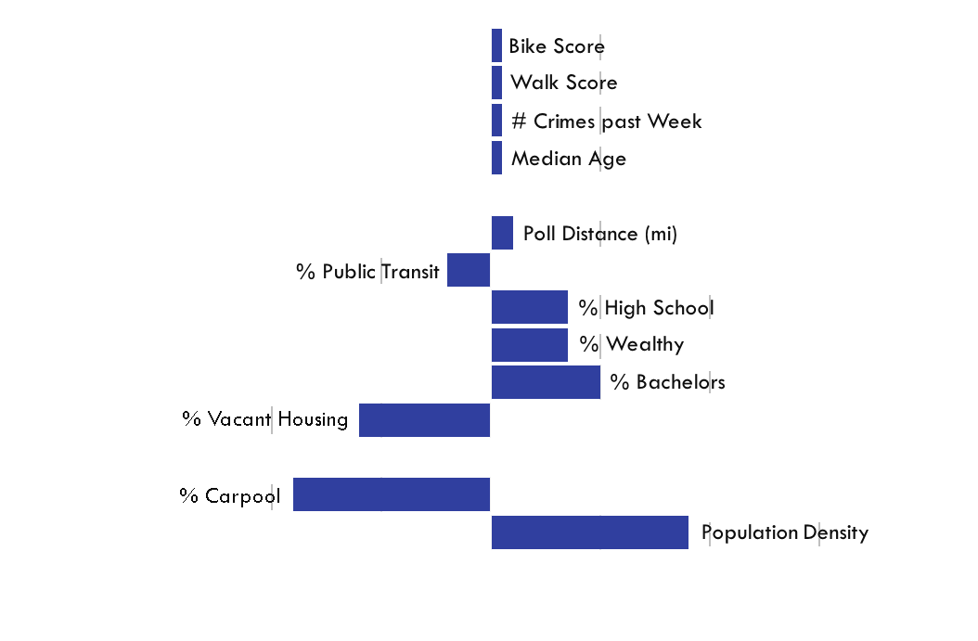
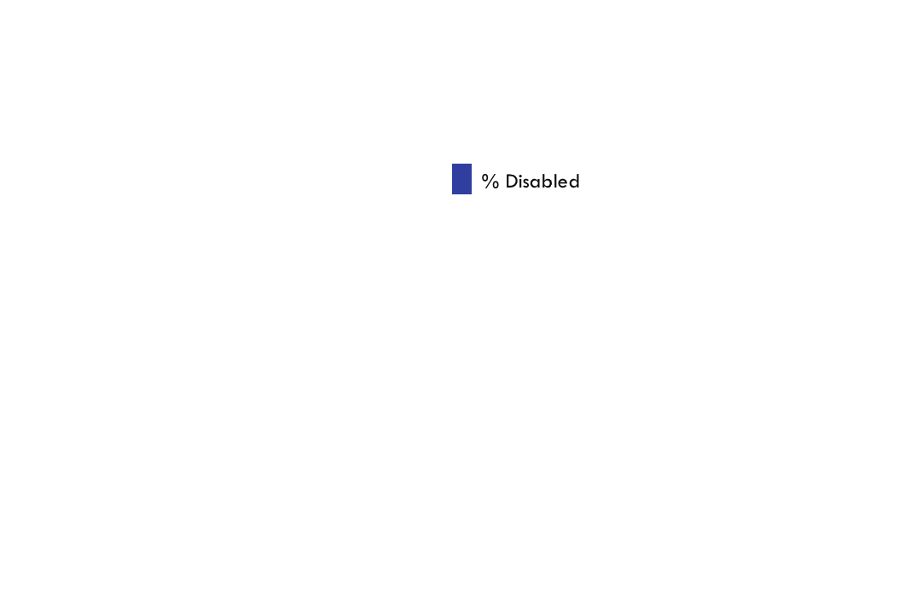
Selected Feature Coefficients
p-value = 0.158
p-value = 0.557

Slide 7
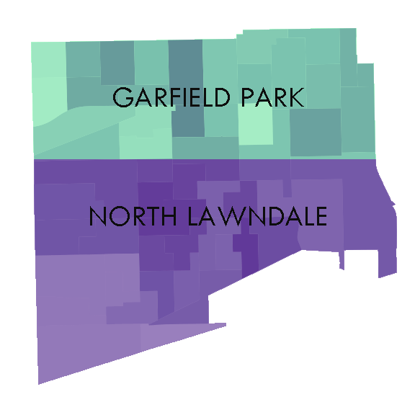
Poverty & voter turnout
 | Voter Turnout | % Poverty
Garfield Park/North Lawndale | 51% | 46%
All of Chicago | 58% | 22%
Difference | - 7% | +24%

Slide 8
Poverty & voter turnout
 | Voter Turnout | % Poverty
Garfield Park/North Lawndale | 51% | 46%
All of Chicago | 58% | 22%
Difference | - 7% | +24%

Slide 9
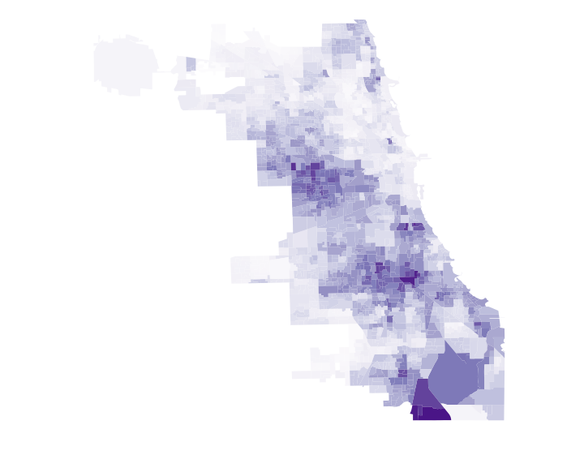
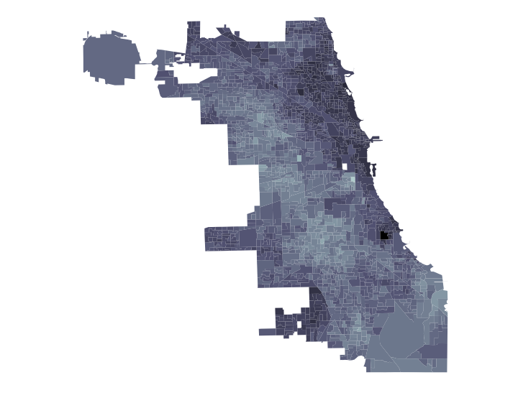


PERCENT POPULATION LIVING IN POVERTY
% POVERTY
% VOTER TURNOUT
0%
100%
0%
100%
1% increase in poverty → 16% decrease in voter turnout

Slide 10
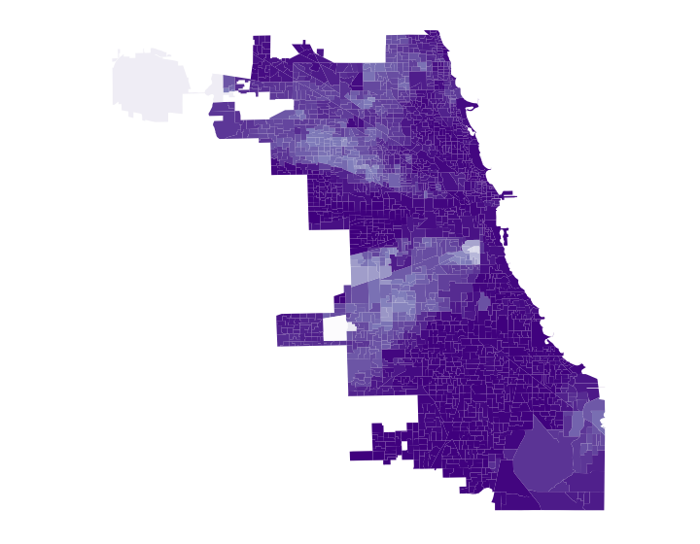
PERCENT POPULATION That speak English well
% ENGLISH
% VOTER TURNOUT
0%
100%
0%
100%
1% increase in English → 32% increase in voter turnout

Slide 11
Conclusion
The data provide a clear connection between voter turnout and demographic/precinct variables
Is it possible to increase voter turnout with targeted outreach?
Increase awareness of early voting / Vote by Mail
Eliminate need to register for Vote by Mail
Election material in languages other than English

Slide 12
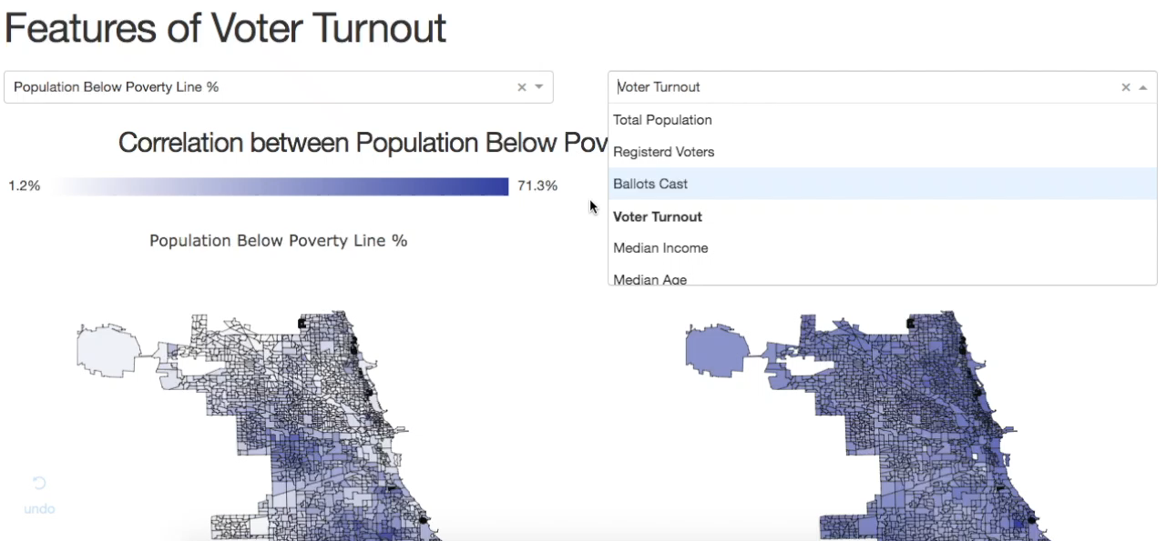
Dashboard – github.com/alex-douglas

Slide 13





Thank you
alex.douglas4545@gmail.com
alexrdouglas.com
@ar_douglas
github.com/alex-douglas

